Slide 1
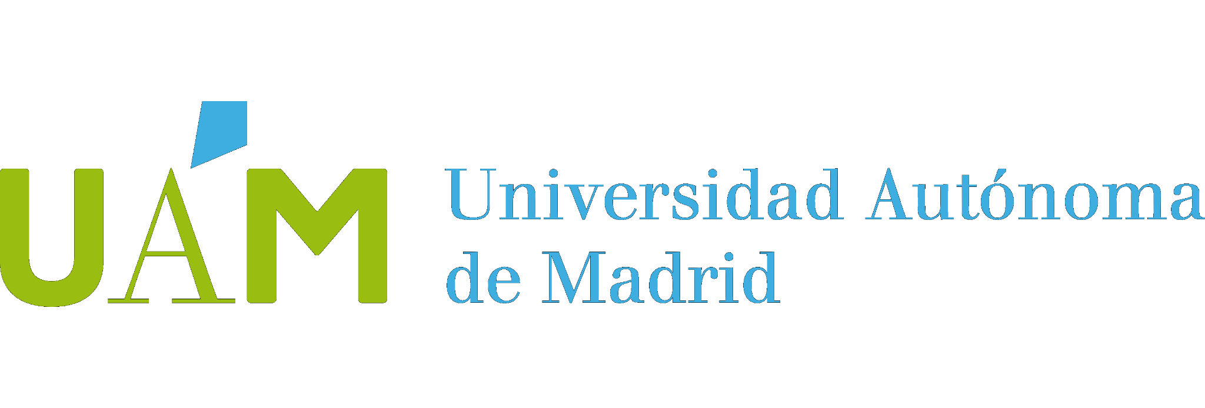

Risks Planning and Management
Presentation
P.D. team
Development team: Rodrigo Juan Guillermo Daniel

Slide 2
INDEX
RISK IDENTIFICATION
RISK ESTIMATION
RISK ASSESSMENT
RISK MANAGEMENT – PREVENTIVE ACTIONS
RISK MANAGEMENT – CORRECTIVE OR MITIGATING ACTIONS

Slide 3
RISK IDENTIFICATION
Risk ID | Short name | Risk description | Risk category
RK1 | Deadline | As a consequence of not estimating correctly the time, a risk of not having the project in time for the deadline may occur, it will happen that the company will go bankrupt. | Classes Project risk: This risk is considered as a project risk because of the poor estimation about how long the project will last. Business risk: This risk is considered a business risk because the company would declare bankruptcy if in the deadline the project is not finished. Categories Estimation and cost: The company performs a bad estimation regarding the time the project would be complete, therefore unrealistic schedules are followed.

Slide 4
RISK IDENTIFICATION
Risk ID | Short name | Risk description | Risk category
RK2 | New personnel training | New technical personnel may not be trained in the project domain, and both the tools and architecture may feel foreign to them, increasing the time needed to finish the project and decreasing production. | Classes Technical risk: This risk is considered technical because the lack of training in the project domain means a threat to the project quality. Project risk: This risk is considered a project risk because the lack of training in the project domain can end up meaning a delay in the software production schedule. Categories Personnel management: A shortage of qualified personnel affects personnel management directly as it is related to the personnel hired.

Slide 5
RISK IDENTIFICATION
Risk ID | Short name | Risk description | Risk category
RK3 | SOFTCOM deadlines | The external company SOFTCOM S.L. might not finish their part in time Working with a external company may delay in the schedule due to late delivery of project components. | Classes Project risk: This risk is considered a project risk because if SOFTCOM misses their final deadline, all the work on top of their final product can not start until they finish, thus delaying the whole project timeline and threatening the project plan. Categories External sources: The company we hire is external to our company hence there are decisions within that company that are out of our control.

Slide 6
RISK IDENTIFICATION
Risk ID | Short name | Risk description | Risk category
RK4 | Google Maps expertise | As a consequence of Lack of expertise with Google Maps SDK or their API DIRECTIONS, a delay in time, or decrease in production speed may occur, it will happen that the software is of low quality or the whole project is delayed | Classes Project risk: This risk is considered as a project risk because of the impact on the project planning that it would have, delaying milestones and workflow. Technical risk: This risk is considered a technical risk because the lack of knowledge with the external tool, might imply a lower level of quality on the final product. Categories External sources: The company’s software is not compatible with the SDK or the API and a new support layer needs to be designed. Personnel management: The personnel is not fluid with the new tools and becomes demotivated with the development due to failure.

Slide 7
RISK ESTIMATION
Risk ID | Short name | Estimation of the likelihood of risk occurrence | Justification of the likelihood of risk occurrence | Estimation of the scale of risk impact | Justification of the scale of risk impact
RK1 | Deadline | Low: 0,4 | As the project estimation was done with the Microsoft Project tool, the estimation would be more likely to be correct. | Very High: 0,8 | The company is forced to finish the project before the deadline, not doing so would cause the company to go to bankruptcy.

Slide 8
RISK ESTIMATION
Risk ID | Short name | Estimation of the likelihood of risk occurrence | Justification of the likelihood of risk occurrence | Estimation of the scale of risk impact | Justification of the scale of risk impact
RK2 | New personnel training | High: 0,7 | As the new personnel is already hired the likelihood is known to not have a lot of experience and this is not expected to change soon. Therefore, the likelihood for this risk to happen is high. | Medium: 0,3 | The lack of training in the project domain would impact the project, as deadlines are tight and budget is already high, but as the project continues, the personnel would gain experience of the project domain and the problem would fade away. This is why the impact factor is medium.

Slide 9
RISK ESTIMATION
Risk ID | Short name | Estimation of the likelihood of risk occurrence | Justification of the likelihood of risk occurrence | Estimation of the scale of risk impact | Justification of the scale of risk impact
RK3 | SOFTCOM deadlines | Medium: 0,5 | SOFTCOM is the only company that has accepted this project with the proposed budget so that might be a hint about their quality, also some critics about the company are not very positive. Nevertheless, there are some good critics, and they are a still existing company (indicating they have projects and more companies trust in them). In a nutshell, there is a 50% (medium) likelihood of them missing a deadline. | Very High: 0,8 | If the SOFTCOM company misses their deadlines, this will be a high impact for the project because it would mean our entire timeline is delayed, and this would mean making it tighter in the final stages which might cause our company not to finish the project in time.

Slide 10
RISK ESTIMATION
Risk ID | Short name | Estimation of the likelihood of risk occurrence | Justification of the likelihood of risk occurrence | Estimation of the scale of risk impact | Justification of the scale of risk impact
RK4 | Google Maps expertise | Medium: 0,6 | The tools have never been used by the personnel and will very likely appear foreign to them. Nevertheless, the SDK and API are expected to be designed to be interface friendly and well documented. | High: 0,4 | The company will be forced to seek external help from experts, educate personnel, decrease workflow, which all greatly impacts the project development and its progress pace (this part of the project should be delivered in the first Increment).

Slide 11
RISK ASSESSMENT
Risk ID | Short name | Priority |  | Breaking points
RK1 | Deadline | According to the results obtained in the risk exposure (0,32), this risk would be the top priority (1/4), which makes sense as the result would be to close the company. |  | A breaking point would be to achieve the deadline without having finished the project. Th commitment in the deadline is inevitable, since it is a 10 times larger project with a very tight deadlines.

Slide 12
RISK ASSESSMENT
Risk ID | Short name | Priority |  | Breaking points
RK2 | New personnel training | As the impact factor of the risk is only medium, the priority of the risk is the fourth, because other risks deserve more attention and higher priority. |  | The breaking point for the team to give up the project due to this risk will be when after too much money is invented for training the team is still not trained enough for the project. As the salaries of the team const 1450 € a day we put the breakpoint at one week of training without working. If this is exceeded and the team is not prepared enough, the project should be canceled.

Slide 13
RISK ASSESSMENT
Risk ID | Short name | Priority |  | Breaking points
RK3 | SOFTCOM deadlines | This is the second risk with more priority behind RK1 this is because its probability is medium and the impact is high making it something to be very aware of and careful. |  | When SOFTCOM misses their deadline, a meeting with them will be set where the reasons for their miss will be exposed, once that happens, the initial extra time for them to finish will be two weeks (Although this can vary depending on the progress they have made and the reasons for the delay).

Slide 14
RISK ASSESSMENT
Risk ID | Short name | Priority |  | Breaking points
RK4 | Google Maps expertise | According to the results obtained in the risk exposure (0,24), this risk would not be of much priority (3/4), which is understandable because of its moderate likelihood. |  | A breaking point would be when the personnel does not understand the external software and production stalls for more than one week. Since this part of the project is contained in the first Increment, no big delays can be tolerated because their impact is bigger on the whole project.

Slide 15
RISK MANAGEMENT – PREVENTIVE ACTIONS
Risk ID | Short name | Preventive actions
RK1 | Deadline | The preventive actions would be as follow: Perform a feasibility study, in order to consider all of the project relevant points and perform a good estimation. Have a milestone at the end of each phase to control the development of the project that is being carried out on time. Give a higher priority to the analysis phase in order to have a correct estimation of the time. Hire a team with experience in projects with tight deadlines.

Slide 16
RISK MANAGEMENT – PREVENTIVE ACTIONS
Risk ID | Short name | Preventive actions
RK2 | New personnel training | The preventive actions would be as follow: To prevent the lack of training of the team we should train the new personnel on the project domain. The team selected to be in charge of the project should be the most experienced with the project domain.

Slide 17
RISK MANAGEMENT – PREVENTIVE ACTIONS
Risk ID | Short name | Preventive actions
RK3 | SOFTCOM deadlines | The preventive actions would be as follow: Weekly meetings with the SOFTCOM company to check on their progress Initial company with the company to be aware of their planning Investigation on the company to see if it is trustworthy Sending an employee of our company to help them with the development and check on the progress

Slide 18
RISK MANAGEMENT – PREVENTIVE ACTIONS
Risk ID | Short name | Preventive actions
RK4 | Google Maps expertise | The preventive actions would be as follow: Train the personnel on the usage of the software through online courses or tutorials. Encourage personnel to get educated in the matter through monetary incentives. Ensure that the new technical personnel, when hired, has some knowledge over the Google Maps domain.

Slide 19
RISK MANAGEMENT – CORRECTIVE OR MITIGATING ACTIONS
Risk ID | Short name | Corrective or mitigating actions
RK1 | Deadline | The corrective or mitigating actions would be as follow: If the company goes to bankruptcy, hire a notary and start negotiations with the creditors. Check every phase is completed on time, if not re-estimate the times of work that remains to be completed in order to be able to finish everything on time.

Slide 20
RISK MANAGEMENT – CORRECTIVE OR MITIGATING ACTIONS
Risk ID | Short name | Corrective or mitigating actions
RK2 | New personnel training | The corrective or mitigating actions would be as follow: To mitigate the risk of the lack of training in the project domain a professional with experience on the project domain could be hired to help and guide the team.

Slide 21
RISK MANAGEMENT – CORRECTIVE OR MITIGATING ACTIONS
Risk ID | Short name | Corrective or mitigating actions
RK3 | SOFTCOM deadlines | The corrective or mitigating actions would be as follow: Hire a new company (Even if it means a higher budget) Hire more personnel so they can carry out the task that was firstly assigned to SOFTCOM

Slide 22
RISK MANAGEMENT – CORRECTIVE OR MITIGATING ACTIONS
Risk ID | Short name | Corrective or mitigating actions
RK4 | Google Maps expertise | The corrective or mitigating actions would be as follow: Hire and expert on the field to guide the development. Hire a temporary batch of programmers that have expertise over the Google Maps domain. Externalise the task and hire another service company to do it instead (higher cost).

